Slide 1

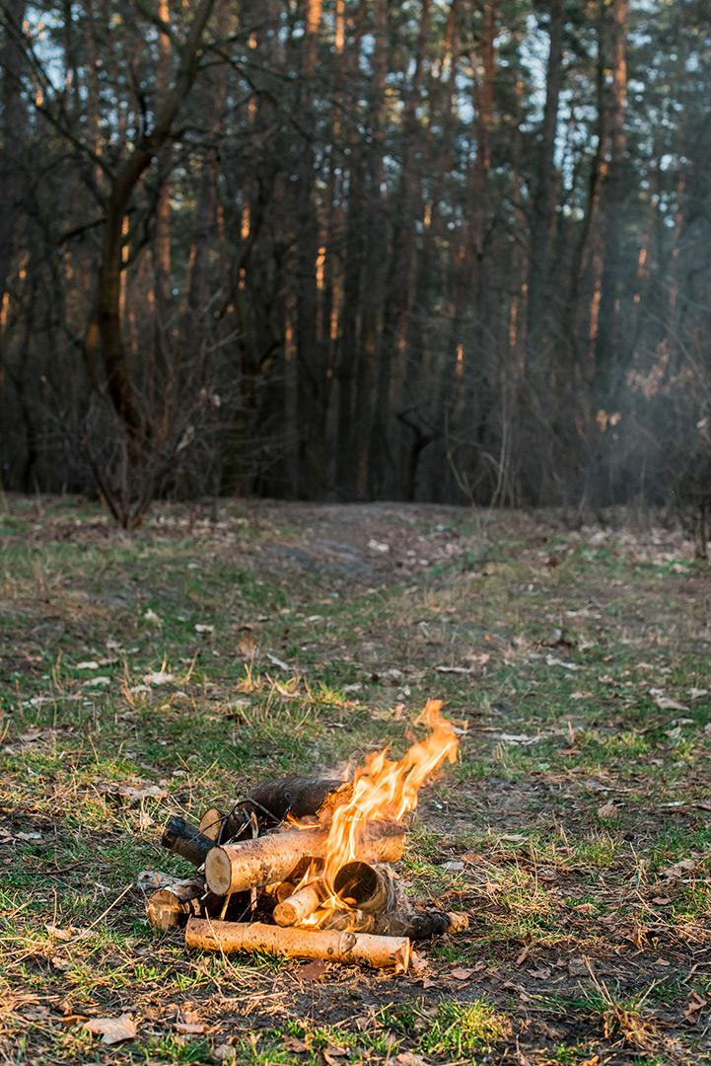
Machine Learning-Based Wildfire Risk Prediction Using Satellite and Weather Data
Team: Ch. Aditya
A.Aaryan
K. Gokul
M. Sathwik
Y. Gokul
Course Coordinator : Dr. K. Swanthana

Slide 2
Table of contents
01
05
02
06
03
07
04
08
Problem Statement
Workflow
Objectives
Innovation & Novelty
Literature Survey
Feasibility Analysis
Research Gap
Plan & Outcomes

Slide 3

Problem Statement
Wildfires cause severe damage to:
Forests and biodiversity
Human settlements and infrastructure
Agricultural land
Wildlife and ecosystems
Air quality and the environment
Existing Challenge
Many wildfire monitoring systems primarily focus on detecting active fires after ignition.
Weather-only approaches may not capture vegetation and land conditions.
Satellite observations provide valuable environmental information but require proper processing and integration.
A simple Fire / No-Fire prediction does not provide enough information for prioritizing high-risk areas.

Slide 4
Problem to Solve
Develop a machine-learning system that predicts wildfire risk before potential fire occurrence by integrating satellite-derived environmental features with weather conditions.
Current Approach
Fire Occurs → Detection → Response
Proposed Approach
Satellite + Weather
↓
ML Prediction
↓
Risk Before Fire
↓
Early Monitoring & Action

Slide 5

OBJECTIVES
Primary Objective
To develop an explainable machine-learning system for predicting location-specific wildfire risk using satellite and weather data.
Specific Objectives
Data Collection: Ingest wildfire, satellite, and meteorological datasets.
Preprocessing & Fusion: Clean and integrate heterogeneous spatial and temporal data.
Feature Engineering: Extract key features (NDVI, Land-Surface Temp, Humidity, Wind Speed, Vegetation Cover).
Model Development: Train and evaluate scalable machine-learning models (e.g., Random Forest, XGBoost).
Risk Quantification: Generate non-binary wildfire probability scores classified into Low, Medium, and High risk.
Explainability & Mapping: Use SHAP for feature explainability and deploy an interactive risk dashboard.

Slide 6
Literature Survey
Paper & Year | Key Approach Used | Identified Limitation / Gap
Exploration of Geo-Spatial Data and Machine Learning Algorithms for Robust Wildfire Occurrence Prediction (2025) | Explores predicting wildfire occurrences using meteorological and geo-spatial parameters alongside ML algorithms. | Highlights the challenge of imbalanced spatio-temporal data and notes the absence of a unified approach across different regions.
Deep Learning for Wildfire Risk Prediction: Integrating Remote Sensing and Environmental Data (2024) | Categorizes deep learning models for spatiotemporal prediction and discusses interpretability techniques like SHAP. | Emphasizes that many DL models act as "black boxes" and often struggle with evaluating feature collinearity.
AutoML-Fire: Automated Machine-Learning Approach to Predict Forest Fires (2025) | Proposes an AutoML framework utilizing Bayesian optimization to handle hyperparameter tuning automatically. | Notes that traditional ML methods require manual intervention for model selection and often struggle with data imbalance.

Slide 7
Paper & Year | Key Approach Used | Identified Limitation / Gap
Environmental Drivers and Spatial Prediction of Forest Fires in the Western Ghats (2023) | Uses spatial variables and vegetation indices for ensemble machine learning prediction. | Focuses heavily on regional vegetation conditions, making it less adaptable for real-time, cross-regional monitoring.
Forest Fire Susceptibility Mapping with Sensitivity and Uncertainty Analysis (2023) | Maps susceptibility using geospatial techniques, ML models (RF, XGBoost), and deep neural network-based sensitivity analysis. | Primarily evaluates static variables (like distance to road and elevation) and highlights the need for dynamic weather integration.
Forest Fire Susceptibility Modeling in the Eastern Mediterranean: A Machine Learning Assessment (2023) | Creates high-resolution susceptibility maps comparing algorithms like Random Forest and SVM. | Relies heavily on historical inventory maps, requiring manual processing of spatial data rather than real-time automated ingestion.
Wildfire Risk Prediction: A Review (2024) | Comprehensively categorizes deep learning approaches and public remote sensing datasets. | Shows a lack of models that successfully couple numerical weather-prediction frameworks with deep learning capabilities.

Slide 8

Research Gap
Current Limitations
Reactive, Not Proactive: Most systems focus on active-fire detection (after ignition) rather than pre-fire susceptibility.
Binary Outputs: Existing models often classify areas strictly as "Fire" or "No-Fire", failing to provide a graded scale for resource allocation.
Siloed Data: Studies usually rely heavily on either static satellite imagery or weather data, rarely fusing them dynamically.
Black-Box AI: Deep learning models provide predictions but lack the explainability needed for emergency responders to trust the data.
The Identified Gap
There is a critical need for a proactive, multi-source framework that fuses real-time weather conditions with satellite-derived environmental data to generate granular, location-specific, and explainable risk scores (Low/Medium/High) before a fire occurs.

Slide 9

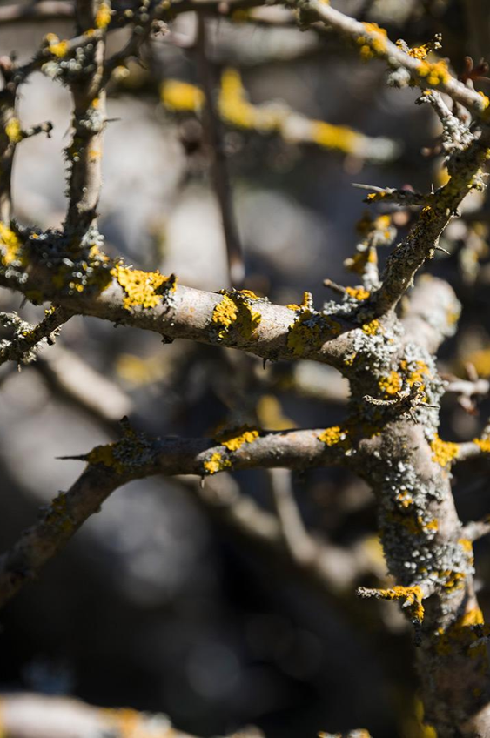
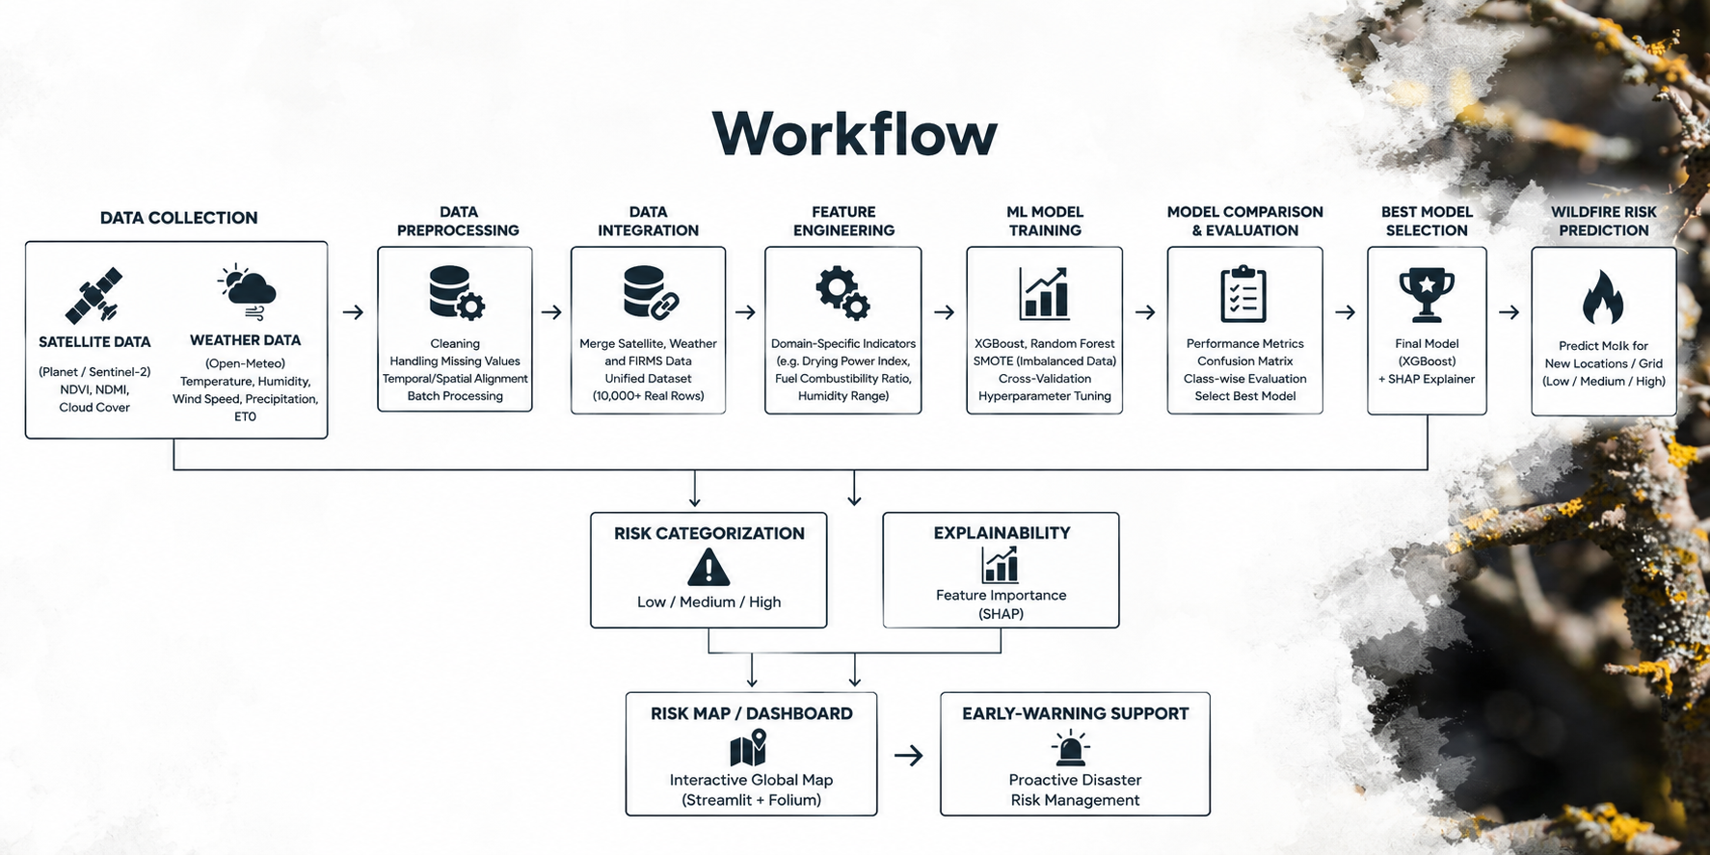
Workflow

Slide 10
Innovation & Novelty
Multi-Source Data Fusion
The Innovation: Moving beyond single-source monitoring.
Details: Dynamically fusing static satellite imagery (NASA/Sentinel) with real-time weather metrics (temperature, wind, humidity) into a single predictive engine.
Explainable AI (XAI)
The Innovation: Solving the "Black Box" problem.
Details: Utilizing SHAP values to provide total transparency. When a region is flagged as high risk, the system explains why (e.g., "High risk driven by 70% wind speed and dry vegetation").
Granular Risk Categorization
The Innovation: Actionable Intelligence.
Details: Shifting away from basic binary "Fire/No-Fire" outputs. Generating a continuous probability score categorized into Low, Medium, and High Risk zones for prioritized resource allocation.

Slide 11
Feasibility Analysis
01
Technical Feasibility
Built using proven, industry-standard machine learning libraries (Scikit-Learn, XGBoost) and open-source geospatial tools (GeoPandas).
02
Operational Feasibility
Relies on stable, free, and publicly available data feeds (NASA FIRMS and Open-Meteo APIs), ensuring continuous and reliable system operation.
03
Economic Feasibility
The architecture is lightweight. Once the model is trained, the inference and dashboard (Streamlit) can run efficiently on standard cloud instances with minimal computational costs.

Slide 12
Plan & Expected Outcomes
Project Plan (Timeline):
Phase 1: Data collection & preprocessing (cleaning satellite and weather feeds).
Phase 2: Feature engineering & ML model training (XGBoost/Random Forest).
Phase 3: Integration of SHAP (Explainable AI) and dashboard UI development.
Phase 4: Final system testing, evaluation, and deployment.
Expected Outcomes:
Predictive ML Model: A benchmarked algorithm capable of forecasting fire susceptibility before ignition.
Interactive Dashboard: A live geospatial map (built with Streamlit) highlighting Low, Medium, and High-risk zones.
Decision Support: A proactive tool that empowers emergency responders to allocate resources efficiently.

Slide 13
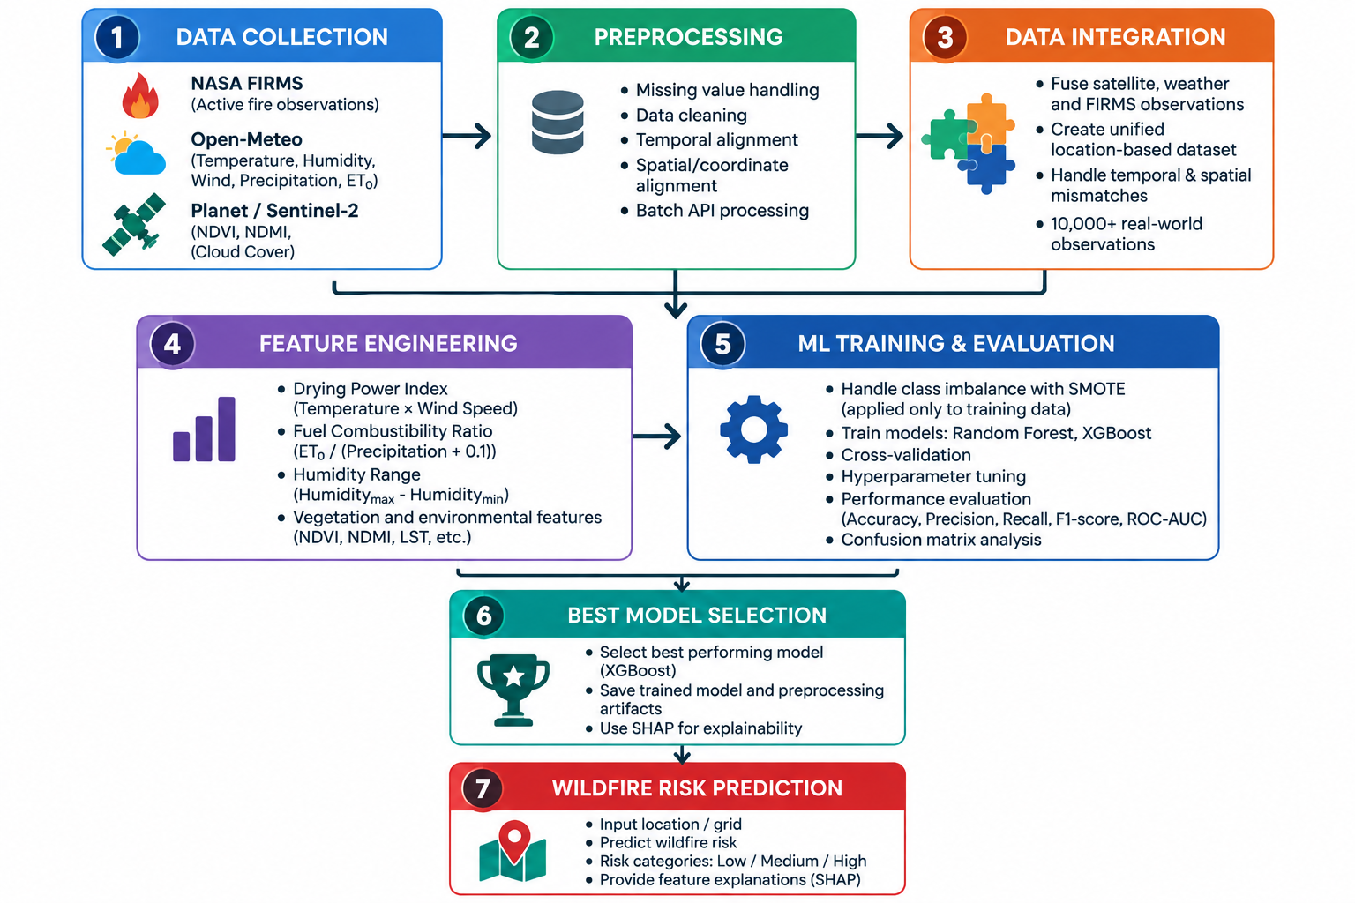
Methodology

Slide 14
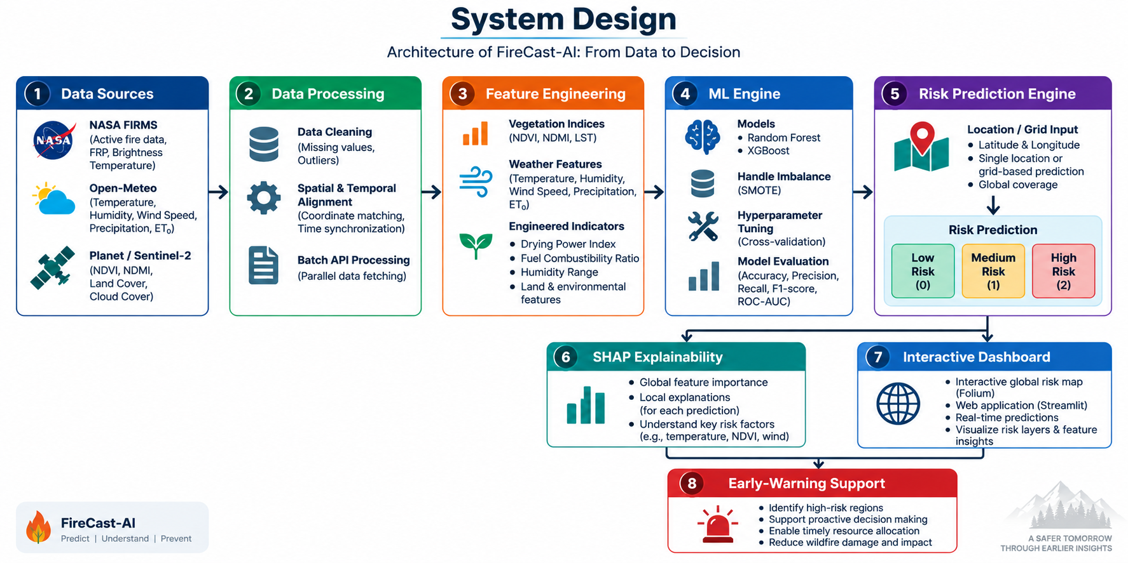

Slide 15
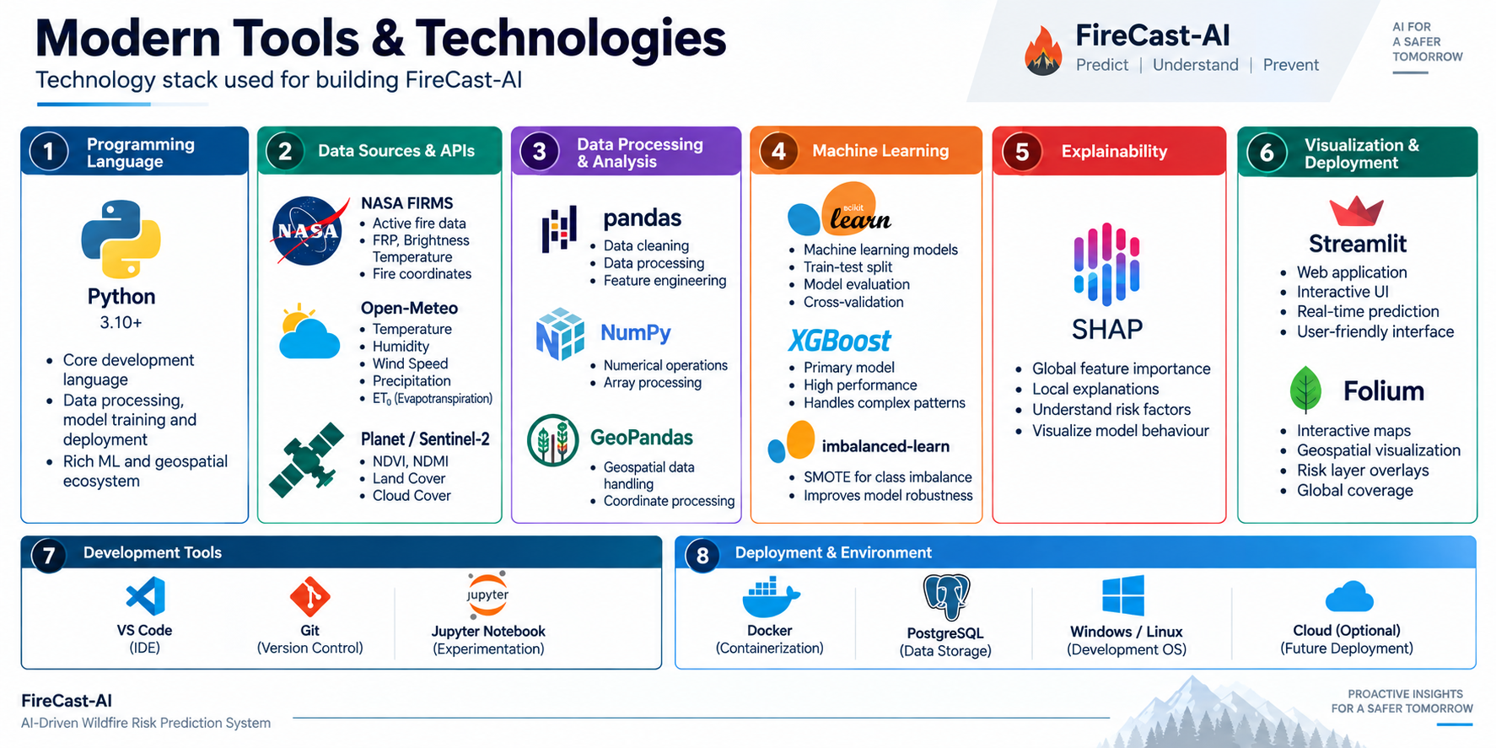

Slide 16
Implementation
• Data Collection
Real-world wildfire, satellite and weather data are collected through NASA FIRMS, Open-Meteo and satellite sources.
• Data Processing
Collected data is cleaned and aligned spatially and temporally before being integrated into a unified dataset.
• Feature Engineering
Environmental and weather indicators such as NDVI, NDMI, drying power and fuel combustibility are derived.
• Model Development
Random Forest and XGBoost are trained using SMOTE, cross-validation and hyperparameter tuning.
• Risk Prediction
The selected model predicts location-specific wildfire risk as Low, Medium or High.
• Explainability & Deployment
SHAP explains the factors behind predictions, while Streamlit + Folium provide an interactive risk dashboard.
Bottom statement
Data → Processing → ML → Risk Prediction → Explainable Decision Support

Slide 17
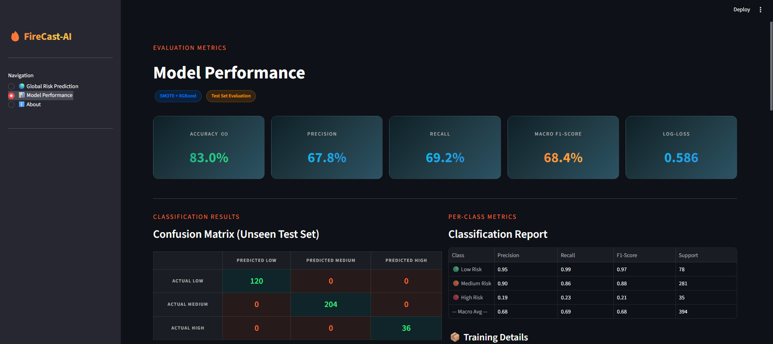
Performance Evaluation

Slide 18
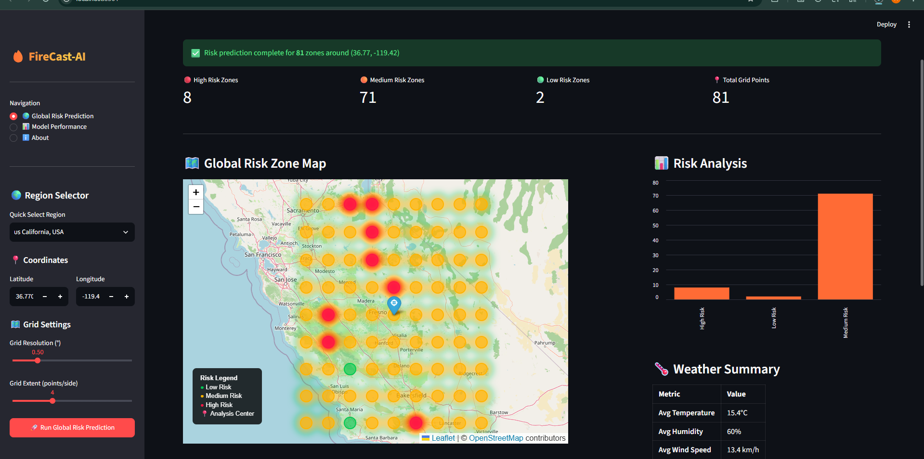
Results

Slide 19
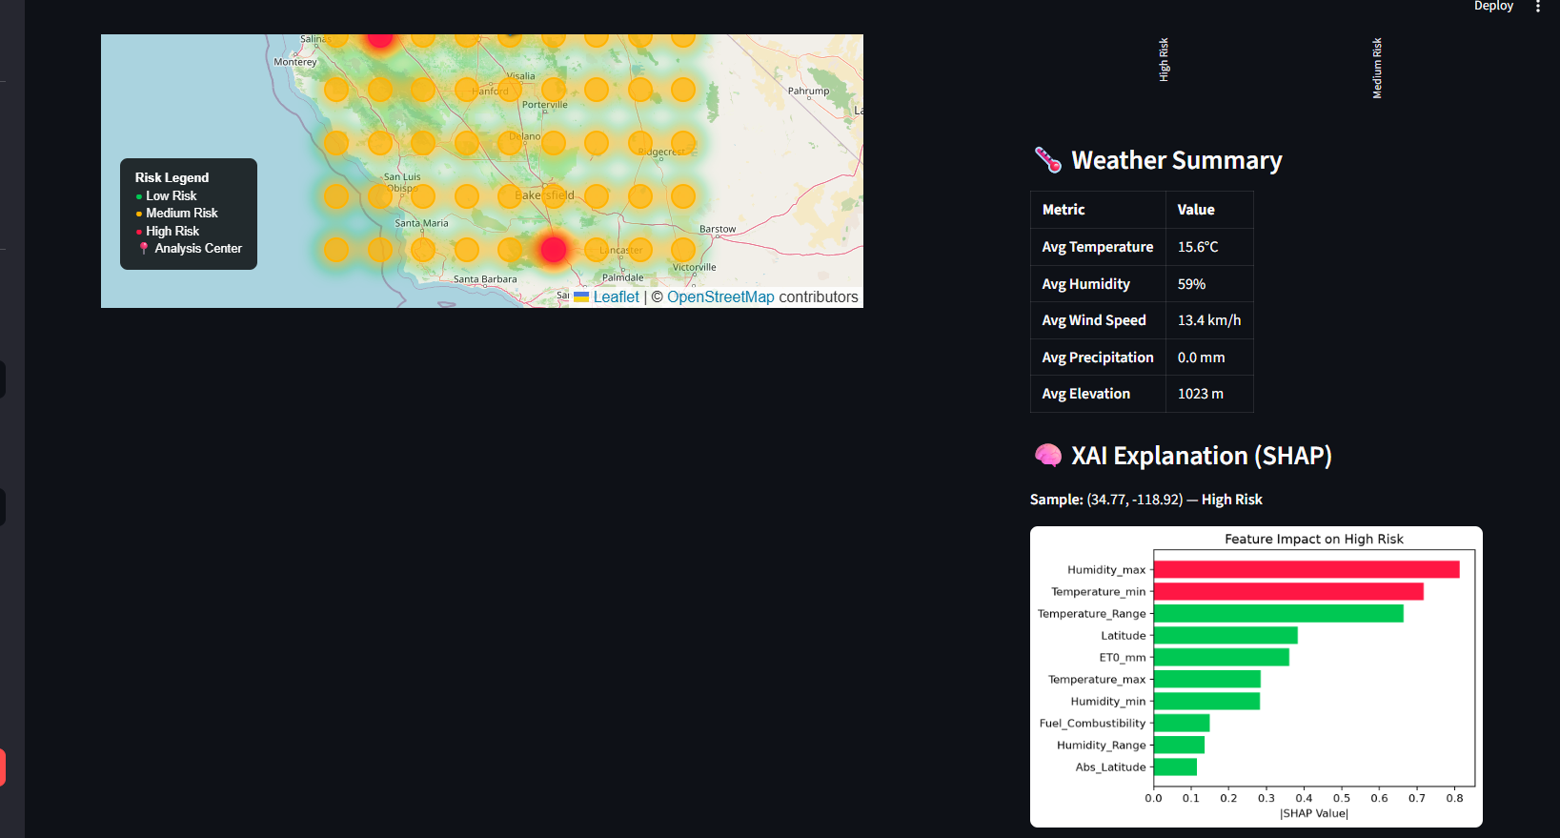

Slide 20
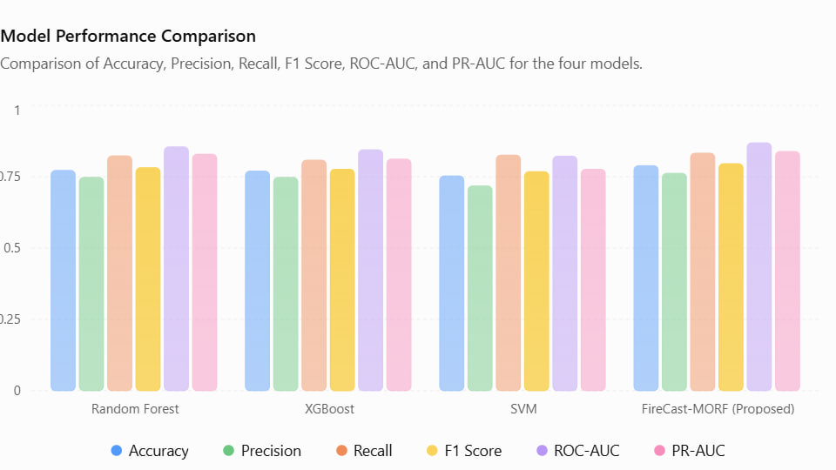

Slide 21
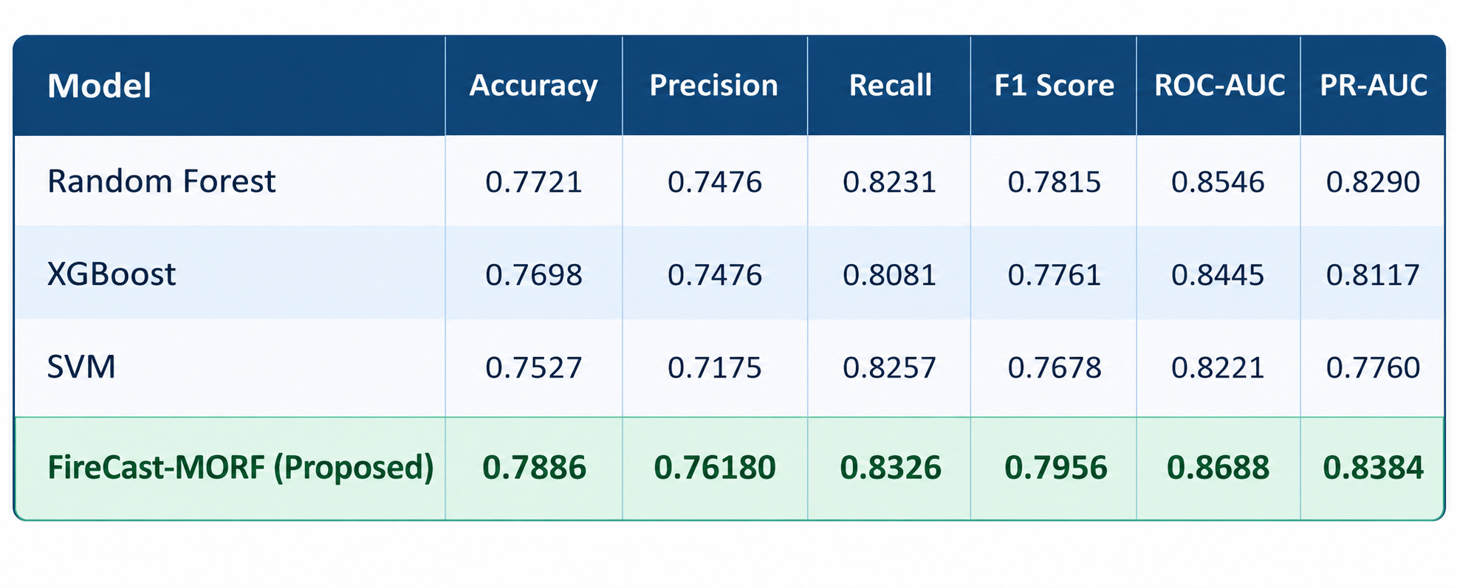

Slide 22

Thank You
BY Ch. Aditya
A.Aaryan
K. Gokul
M. Sathwik
Y. Gokul

